Slide 1
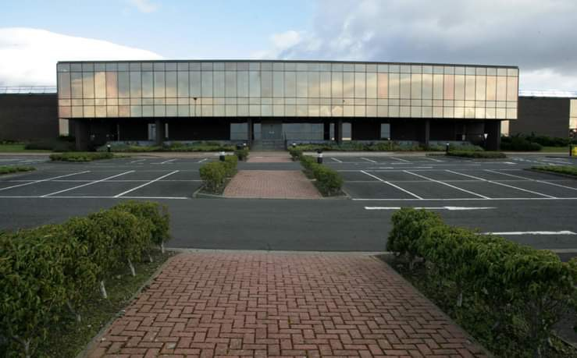
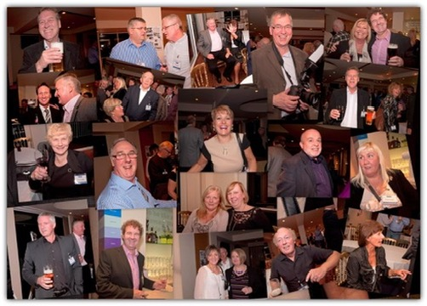

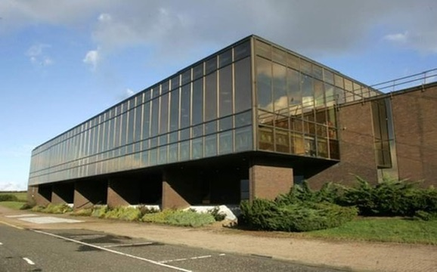
Legacy of Ayrshire’s Silicon Glen
Digital - Compaq - HPE
Robbing Constituents’ Retirement

Slide 2
Meeting Objectives
Meet one another & understand intent
Define the problem troubling many of your constituents
Describe attempts to correct this injustice
Propose short term actions and long - term goals

Slide 3
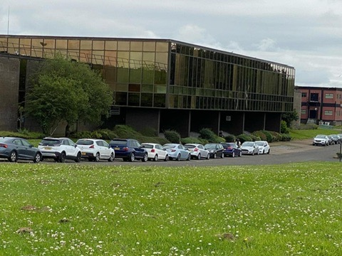
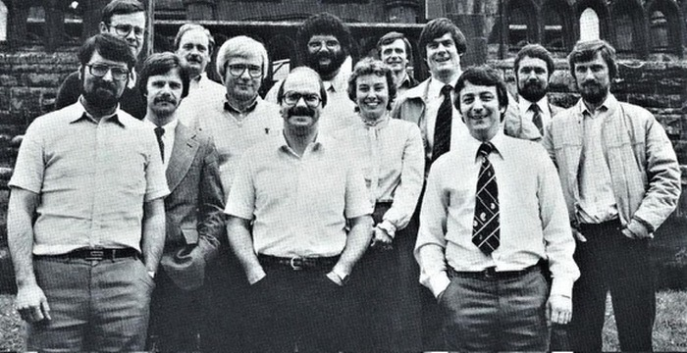
Digital’s UK legacy is most visible in Ayrshire
Digital Scotland (DESL)
Mosshill Site
Manufacturing Plant
Field Mfg Info Centre
Other hosted functions
E.g. European Quality
Logistics (Irvine)
South Queensferry site
Field service & sales (Livingston and other locations)
Largest employer in West of Scotland other than the government
“6000” Hired
Primarily local people
Part time
Contract
Suppliers & Services- local & UK
Rest of the large workforce spread across UK; HPE HQ now Winnersh

Slide 4

Q: Why is the UK the only place in the world where HPE does not give increases to its Pre 97 pensioners?
A: Because the law permits it.

Slide 5






“Ownership” Changes, Pension Erosion
Digital Equipment Corp
Founded 1957
Merged with Compaq
1998
Bought by HP
2002
HP-HPE Split
2015
2024
Do what’s right
Only do what’s legally required
Largest merger in
computer industry history
Of the estimated 6000
hired in Ayrshire,
large number are now
pensioners
Fastest growing company for 30 years
DEC 1.5B$
Mosshill Ayr 1977
Inflation
Pension Erosion of up to 70%
1990
120K People
14B $ Revenue
Discretionary increases matched inflation 97% until HPE took over
3 increases since (1%, 1%, 3%)
past 22 years
Survivor benefits 60% - of the reduced value pension

Slide 6
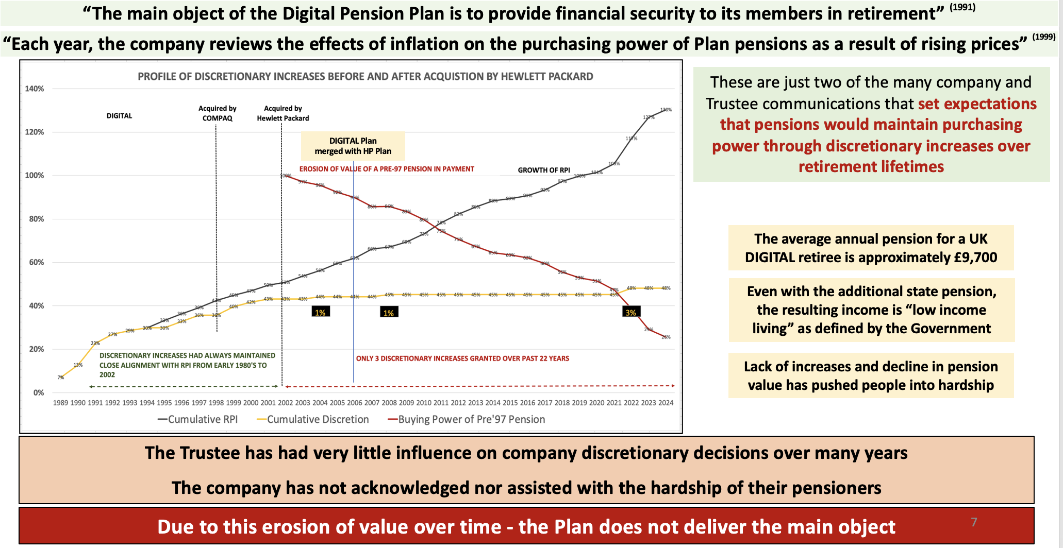

Slide 7

What has been done
HPPA (Pensioners Association) formed 2017; preceeded by Digital Pension Action Group
Many people have tried many methods
Letters & Meetings
Ombudsman
Representations to DWP & TPR including DB Funding Code related to PA2021
Oral evidence Pensions Select Committee Inquiry into DB Pensions; one recommendation included in Final Report
Question to Annual Shareholders Meeting
Recent meeting with Trustee
Breech of good faith
Alliance starting to form
Two WM debates 2024
Demonstration of 200 pensioners HPE HQ late 2023
Media
6 articles last year by Patrick Hoskings, The Times
Many other articles and some TV coverage
Recent article Mail on Sunday
Others expected; photo from today?
General pattern was no real exchange
HQ passes to UK
It’s legal, “go away”, “talk to the Trustee”
Revelation resulted from Allan Dorans’ letter to Patricia Russo, CEO
“Fundamental error” revealed in UK MD Harris’ reply to Dorans’ letter but left unanswered by timing of election
Needs your help to reply

Slide 8
Key objectives towards improving outcomes for pensioners
Use influence to get select committee recommendations delivered to Parliament & implemented
Advocate for use of Code of Ethical practice “now” for large multi-nationals exploiting the “flaw in the law”
Determine the scale of the Pre 97 problem
Advocate research into the findings from TPR research into pre-97 treatment by top 200 companies (80%)
Support using findings to inform policy development and future changes to pensions legislation

Slide 9
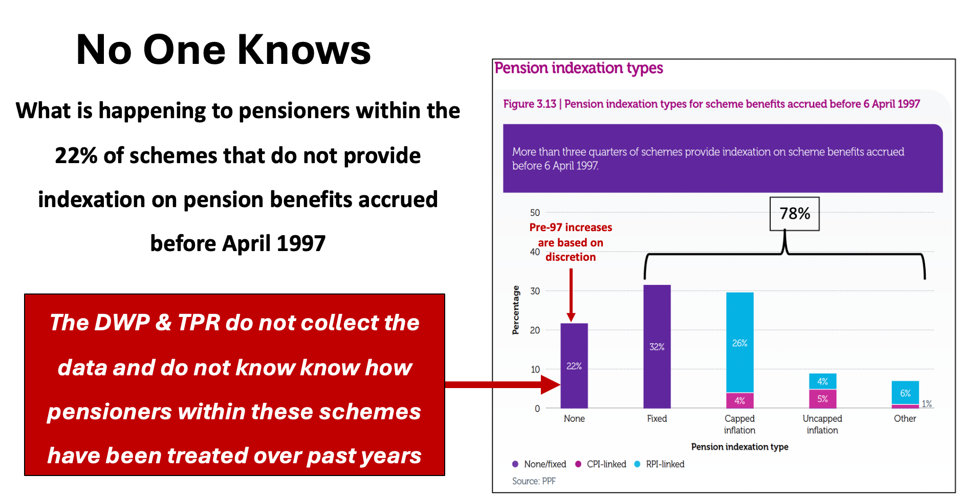

Slide 10
Possible Next steps
Your thoughts?
How can we help you to help your constituents?
Meeting with Alan Gemmell MP?
Review & send our draft letter to Matthew Harris HPE sent in reply to Allan Dorans’ letter?
We are available anytime to help on this issue!
Quarterly meetings?

Slide 11
Further Info

Slide 12
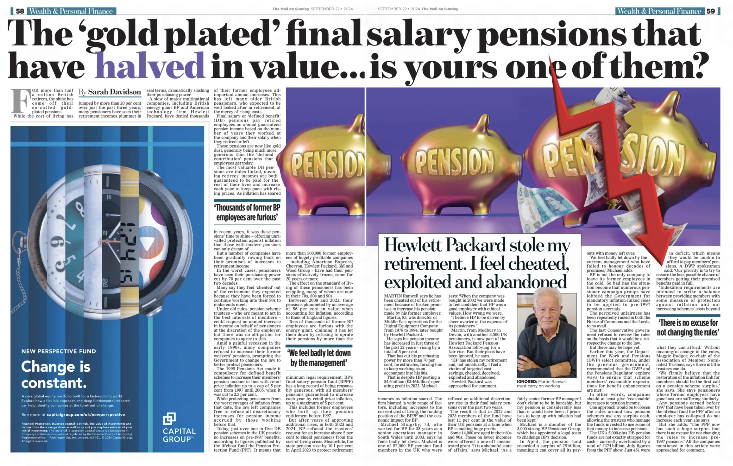

Slide 13


Slide 14
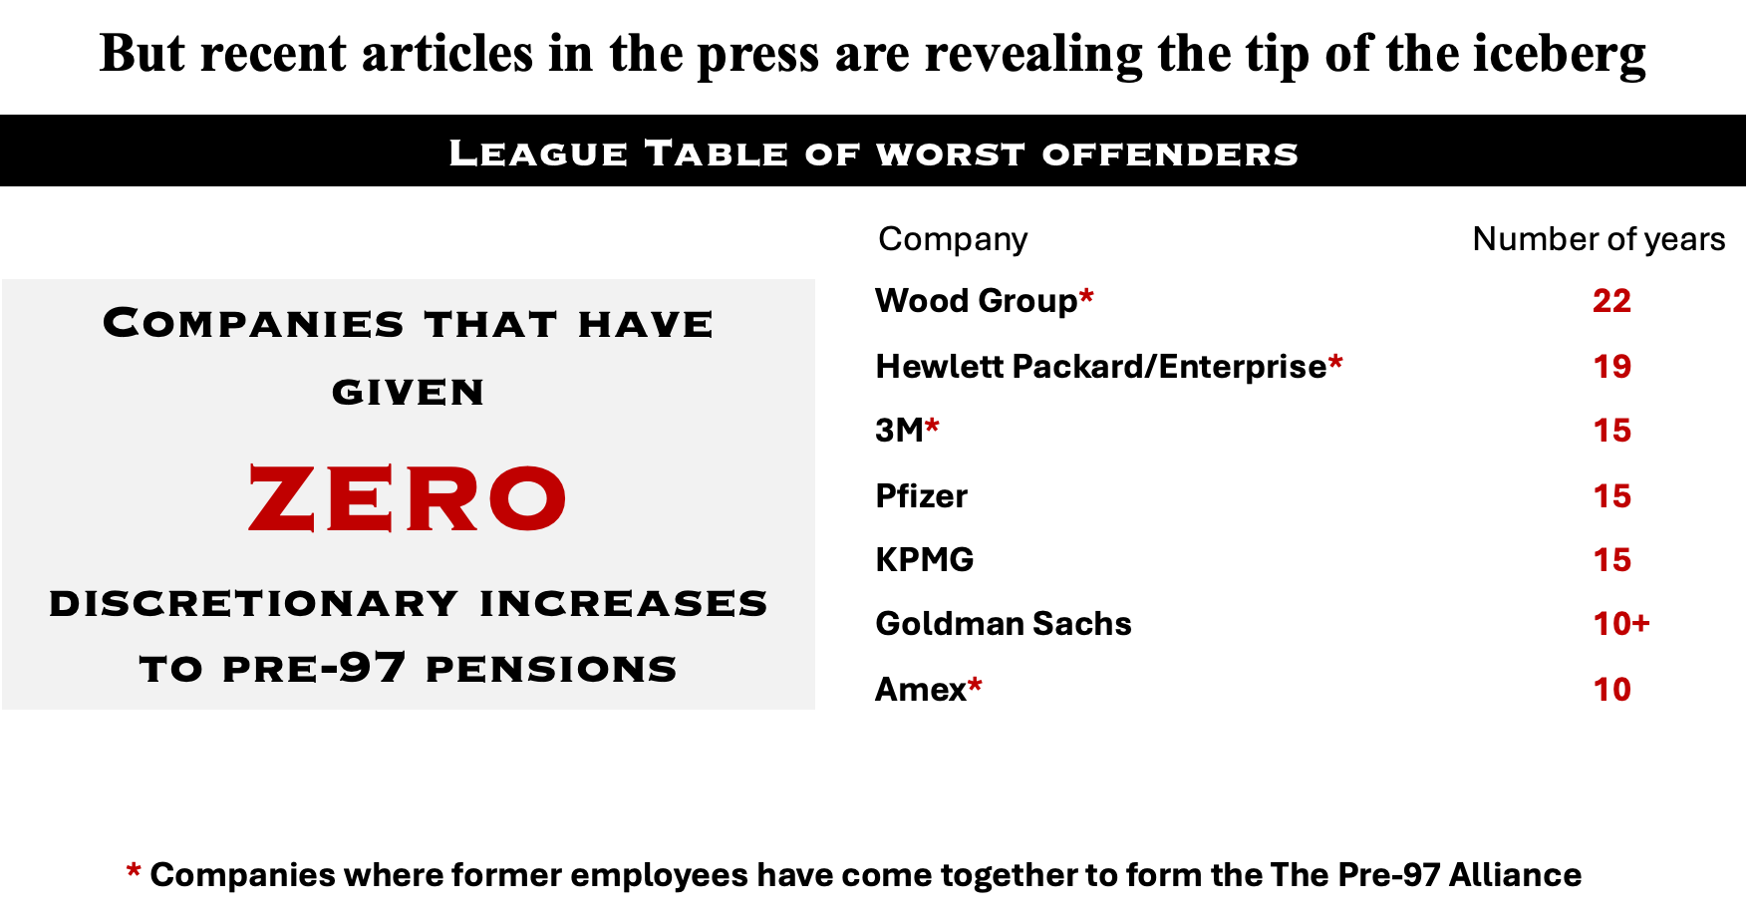

Slide 15
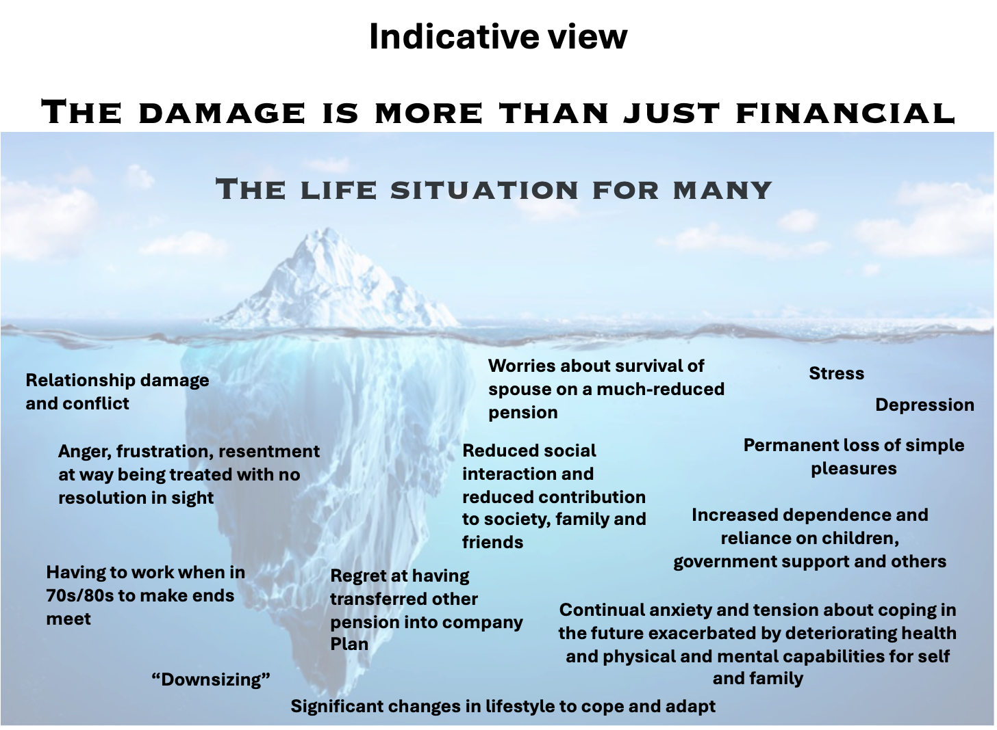

Slide 16
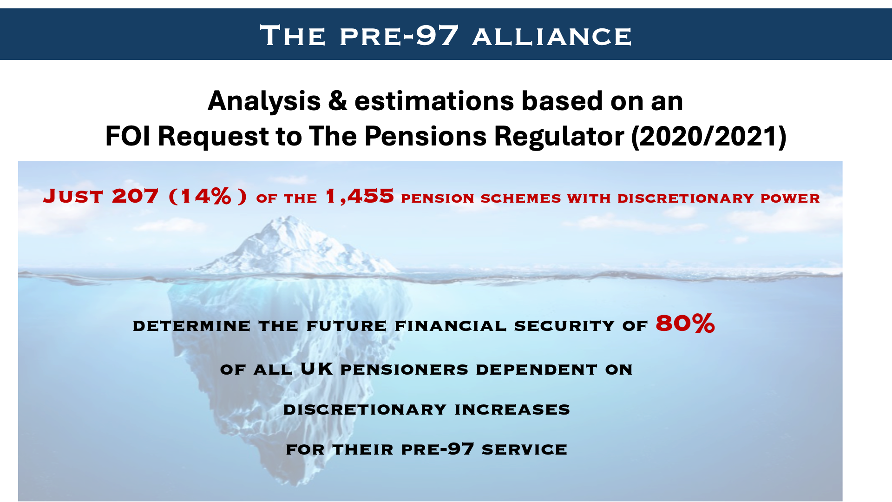

Slide 17
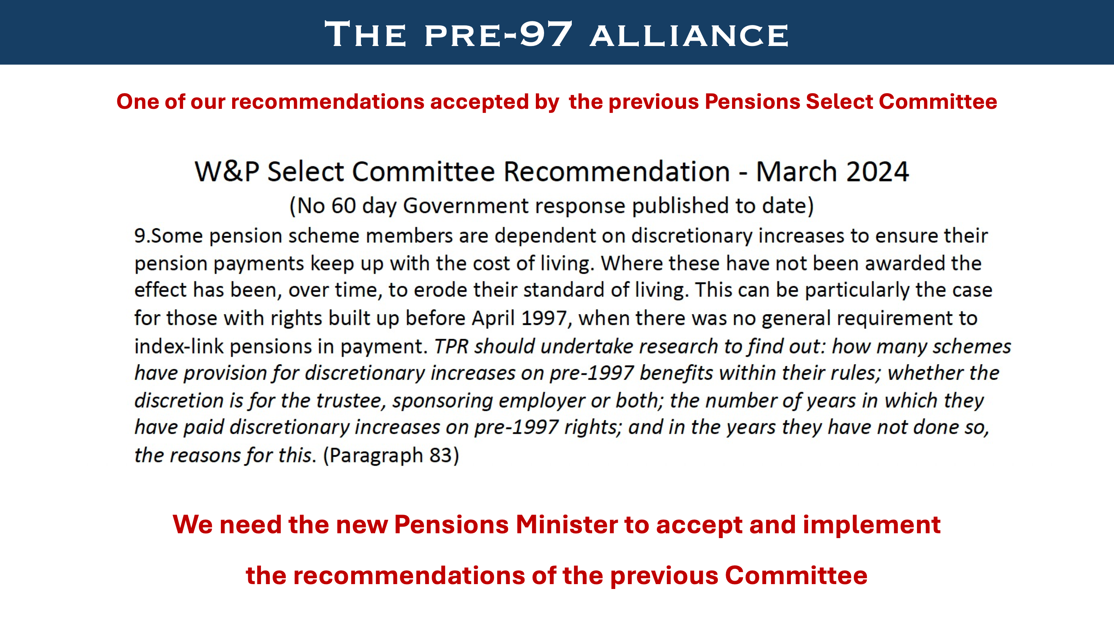

Slide 18
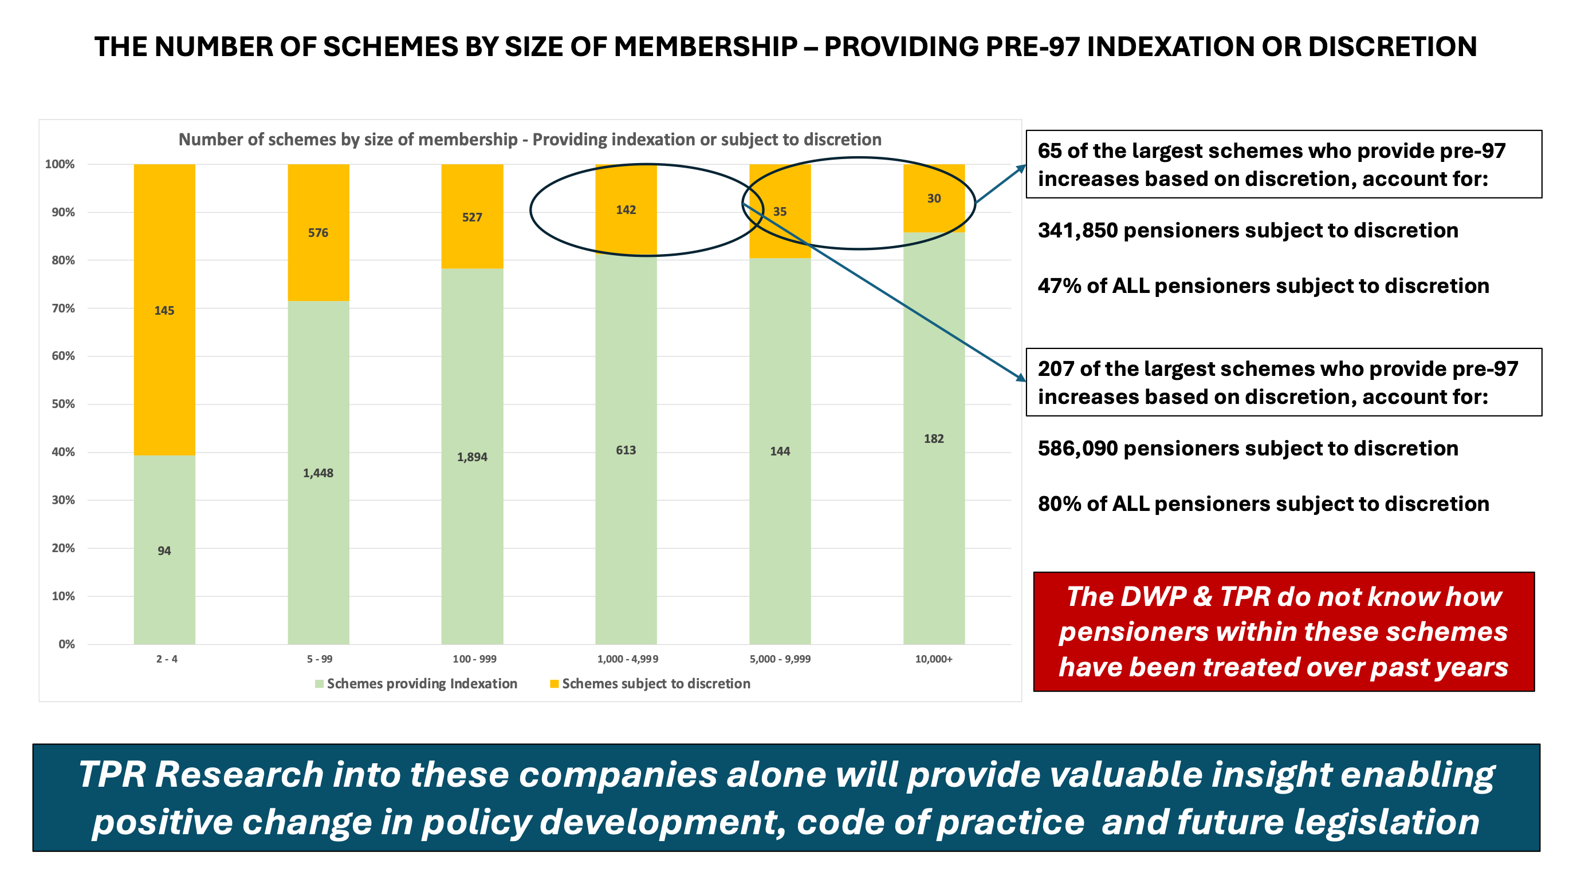

Slide 19
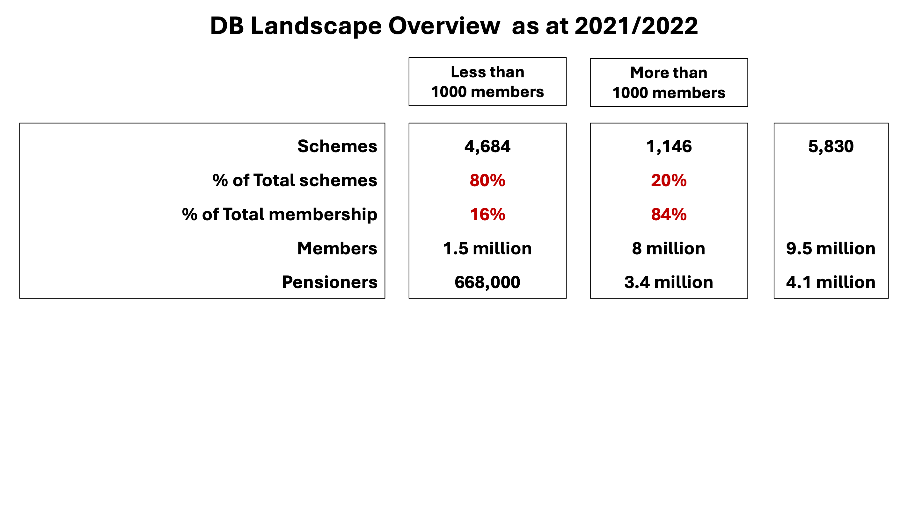

Slide 20
