Slide 1


Slide 2
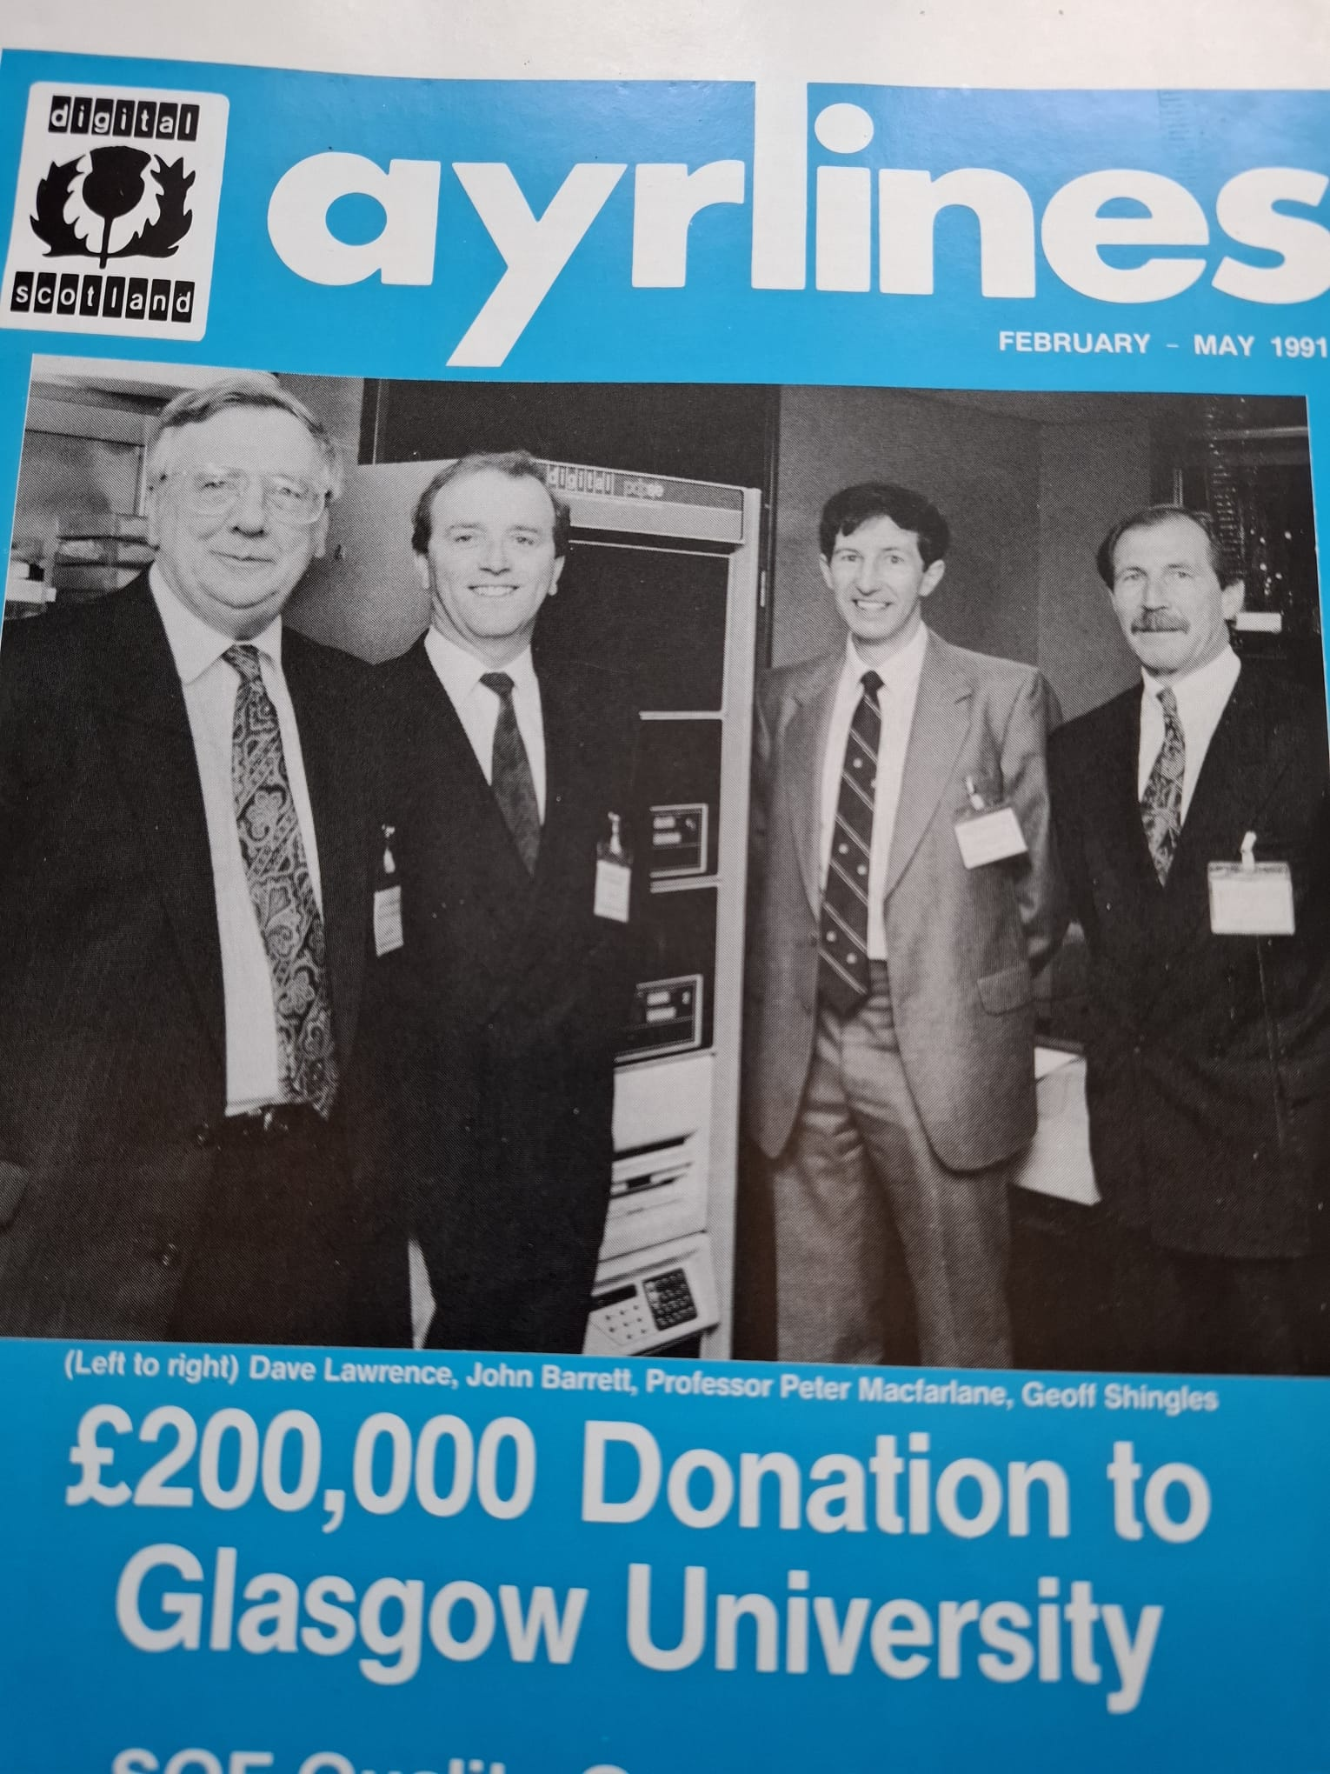
1966

Slide 3

Connect
HPPA Pension Justice Campaign Update Nov 2024
Collaborate
Aims
Quick Tour of Past
View of Campaign Aims & Plan
What We Ask of You
Change
the system

Slide 4

Thinking about pensions
Why didn’t I pay attention more/sooner?
What will happen to my family?
Did I make the wrong decision?
Can leave us feeling
Confused
Anxious
Depressed
Worn out & worn down
Fearful of the future
I feel like an idiot. I’ve been conned. I am angry.

Slide 5

Focus
Pre 97 employment
Digital Section of
HPE Pension Plan
Deferred
Post 97 employment

Slide 6






Quick tour of Past
“Ownership” Changes, Deliberate Pension Devaluation
Digital Equipment Corp
Founded 1957
Merged with Compaq
1998
Bought by HP
2002
HP-HPE Split
2015
2024
Do what’s right
Only do what’s legally required
Largest merger in
computer industry history
Of the estimated 6000
hired in Ayrshire,
large number are now
pensioners
Fastest growing company for 30 years
DEC 1.5B$
Mosshill Ayr 1977
Inflation
Pension Devaluation of up to 70%
1990
120K People
14B $ Revenue
Discretionary increases matched inflation 97% until HPE took over
3 increases since (1%, 1%, 3%)
past 22 years
Survivor benefits 60% - of the reduced value pension

Slide 7
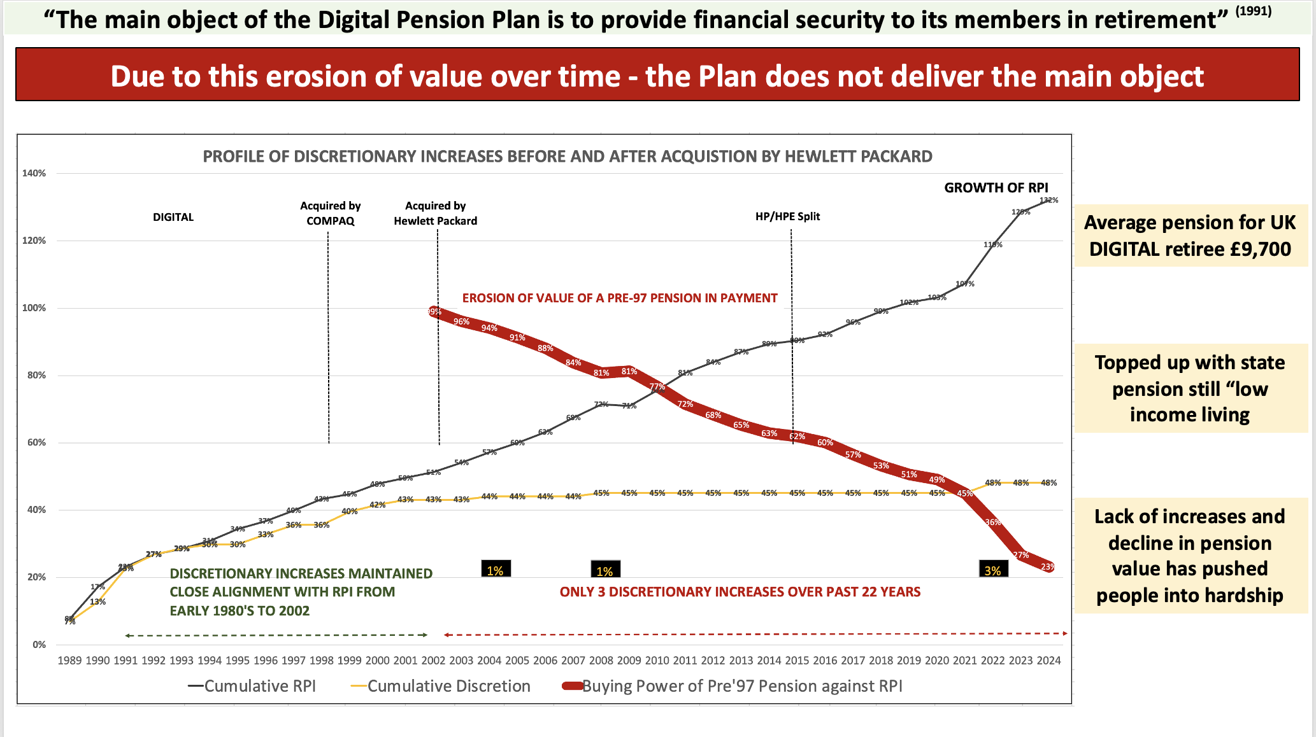
Erosion of value of pre-97 pension against RPI

Slide 8
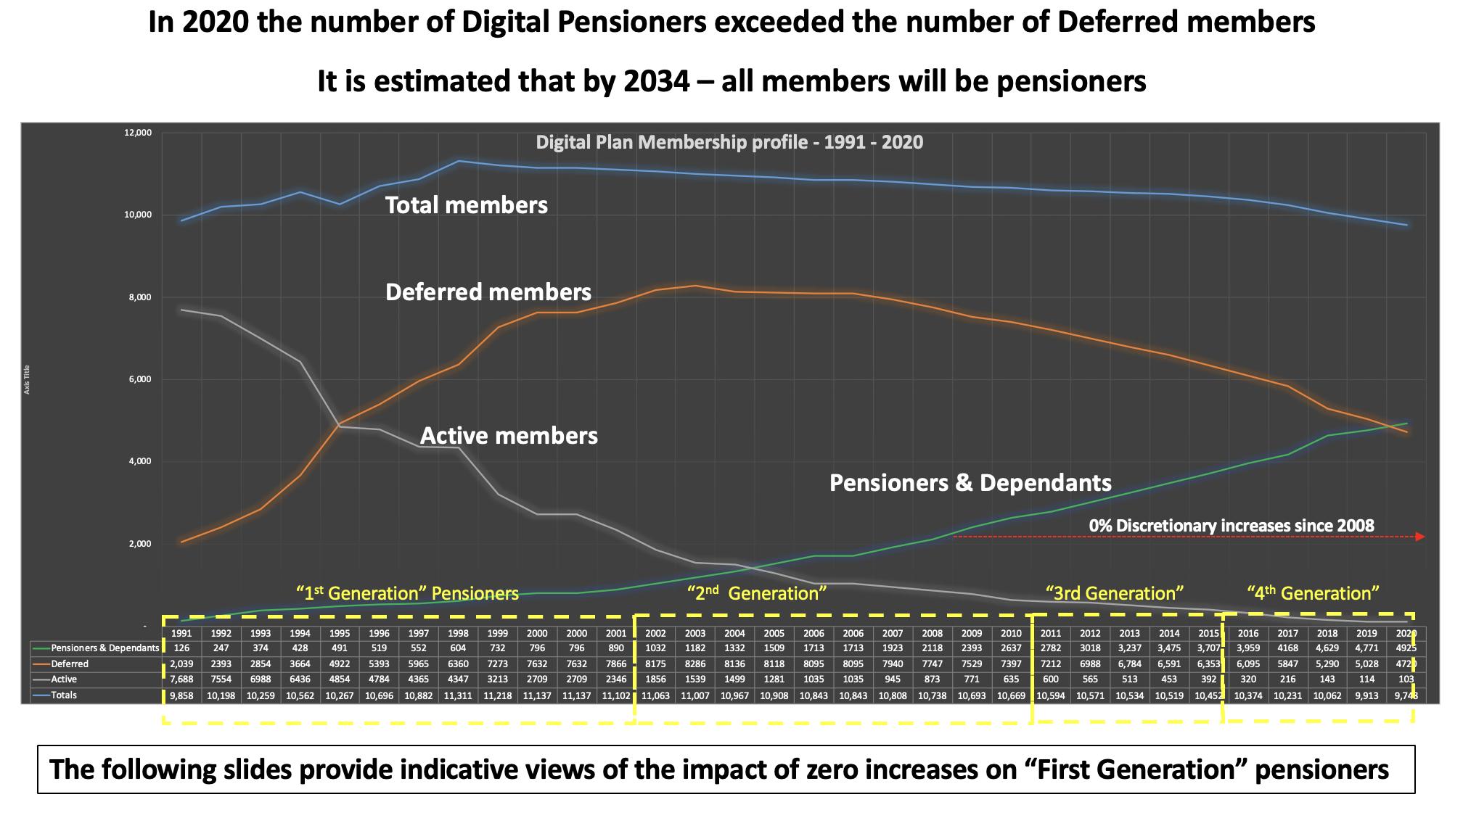

Slide 9
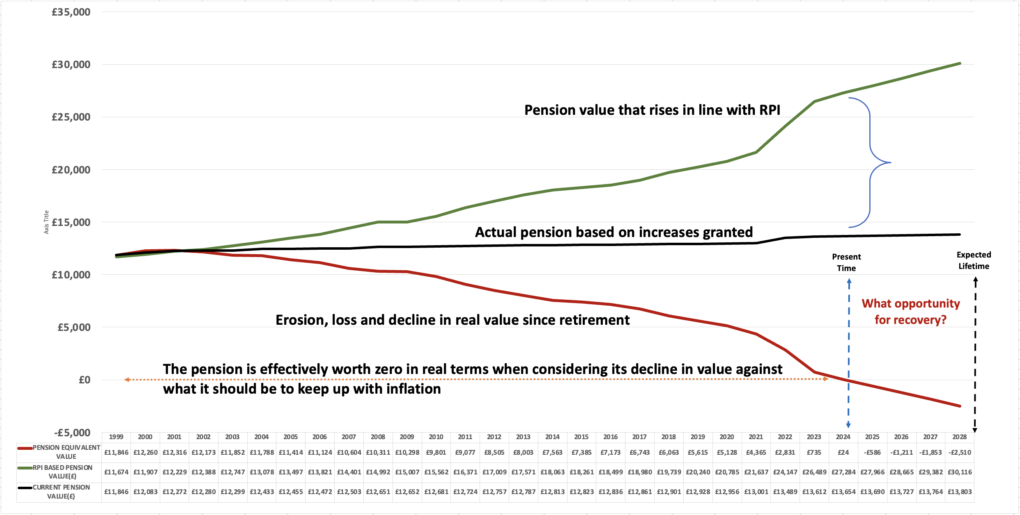
Indicative view of the decline in pension value “First Generation” Pensioner (based on HPPA 2021 survey data)
Average age now ranging mid-70’s to early 80’s
Approximate years service 1975 - 1999
Approximate year retired 1999
Average years service 18 years
Approximate pension when retired: Pre’97 (£10,800) post ‘97 (£600)
Current average pension value £13,600 (RPI pension would be (£27,000)

Slide 10
Indicative view of cumulative “lost income” of “First Generation” pensioner

Slide 11
Indicative view of the decline in pension value “Fourth Generation” Pensioner (based on HPPA 2021 survey data)
Average age now around 68
Approximate years service 1984 – early 2000’s
Approximate year retired 2018
Average years service approx. 16 years
Approximate pension when retired: Pre’97 (£11,800) post ‘97 (£3000)
Current average pension value £16,400 (RPI pension would be (£21,200)

Slide 12
Indicative view of cumulative “lost income” of “Fourth Generation” pensioner

Slide 14


Slide 15

Q: Why is the UK the only place in the world where HPE does not give increases to its Pre 97 pensioners?
A: Because the law permits it.

Slide 16

What has been done
HPPA (Pensioners Association) formed 2017; preceeded by Digital Pension Action Group
Many people have tried many methods
Letters & Meetings
Ombudsman
Representations to DWP & TPR including DB Funding Code related to PA2021
Oral evidence Pensions Select Committee Inquiry into DB Pensions; one recommendation included in Final Report
Demonstration of 200 pensioners HPE HQ late 2023
Question to Annual Shareholders Meeting
August meeting with Trustee
Breach of good faith
Alliance starting to form
Two WM debates 2024
Media
6 articles last year by Patrick Hoskings, The Times
Many other articles and some TV coverage
Recent article in Daily Record & Mail on Sunday
Others expected; photo from today?
General pattern was no real exchange
HQ passes to UK
It’s legal, “go away”, “talk to the Trustee”
Gear change
Revelation resulted from Allan Dorans’ letter to Patricia Russo, CEO
“Fundamental error” revealed in UK MD Harris’ reply to Dorans’ letter but left unanswered by timing of election
Over 112 recent letters to 65 MPs & several meetings
Labour led meeting with Minister planned before Christmas
Need your help continue

Slide 17

Next Slide is for the “Detail Devils” Amongst Us

Slide 18
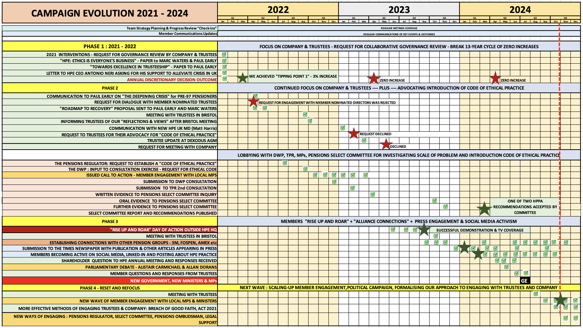

Slide 19
FORCE FIELD ANALYSIS
Dynamic is changing
Driving Forces
Restraining Forces
Increased & sharper focus on company leadership & Trustees
Trustee mindset of having “no power”
Members meeting & writing to their MP to advocate support for DPW to identify the problem
Members unaware, angry,
given up
MPs lack of understanding of issue and/or poor levels of advocacy
Joining up with other pension action groups
Change of government lost focus of the created over past years
Increasing media coverage

Slide 20

Campaign Aims
Stop further pension devaluation
2. Stop pension buy-out without a positive outcome for pre 1997 service
3. Some form of recovery

Slide 21

Just One Thing, please
Our Advocates in the House Are Speaking For Us
We have been asking our MPs for their help in getting one single item on the new Work and Pension Committee agenda.
“DWP/TPR undertake the research to understand the scale of the problem, how many schemes have not granted pre-1997 discretionary increases over many years and the reasons for this”
Once the problem is known, there undoubtedly will be a range of possible solutions. But until the problem is known & visible, positive change is unlikely. Until the research is done, solving the problem is like shooting in the dark.

Slide 22

Once problem is visible
Possible ways forward might be –
Government sponsored code of ethical conduct
Government emphasis on the intent of Pension Act 2021
Government support for government contracts to only go to companies that solve their own Pre-97 problems
and other ways forward

Slide 23
How?
Reconnect our community
Work through government to get issue ”visible”
MPs, new Work & Pensions Committee
Work with media to raise the profile
Work with Trustee to improve governance & help them to help us
Work with other companies with same problem
Be on the lookout for other routes & opportunities

Slide 24

What We Ask Of You
Spread the word
Answer our calls for action
Volunteer
Support us with feedback

Slide 25
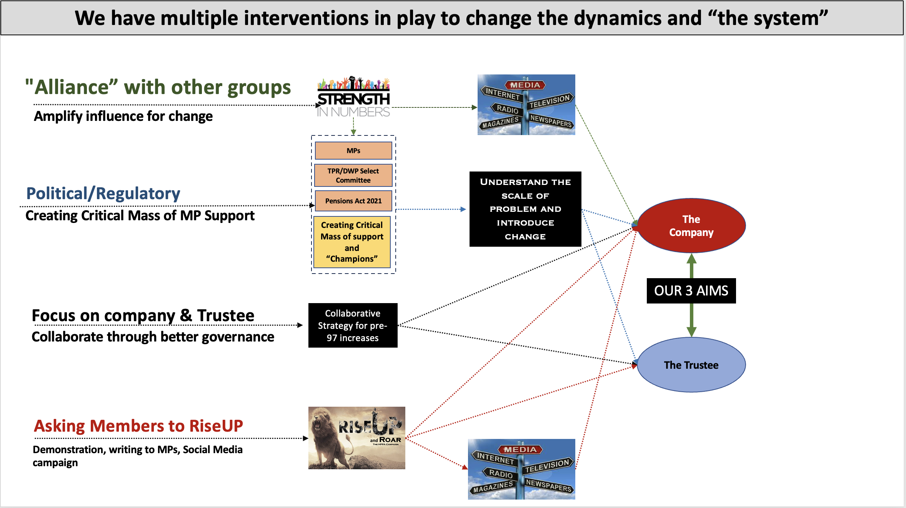

Slide 26

The Devil is always in the detail

Slide 27
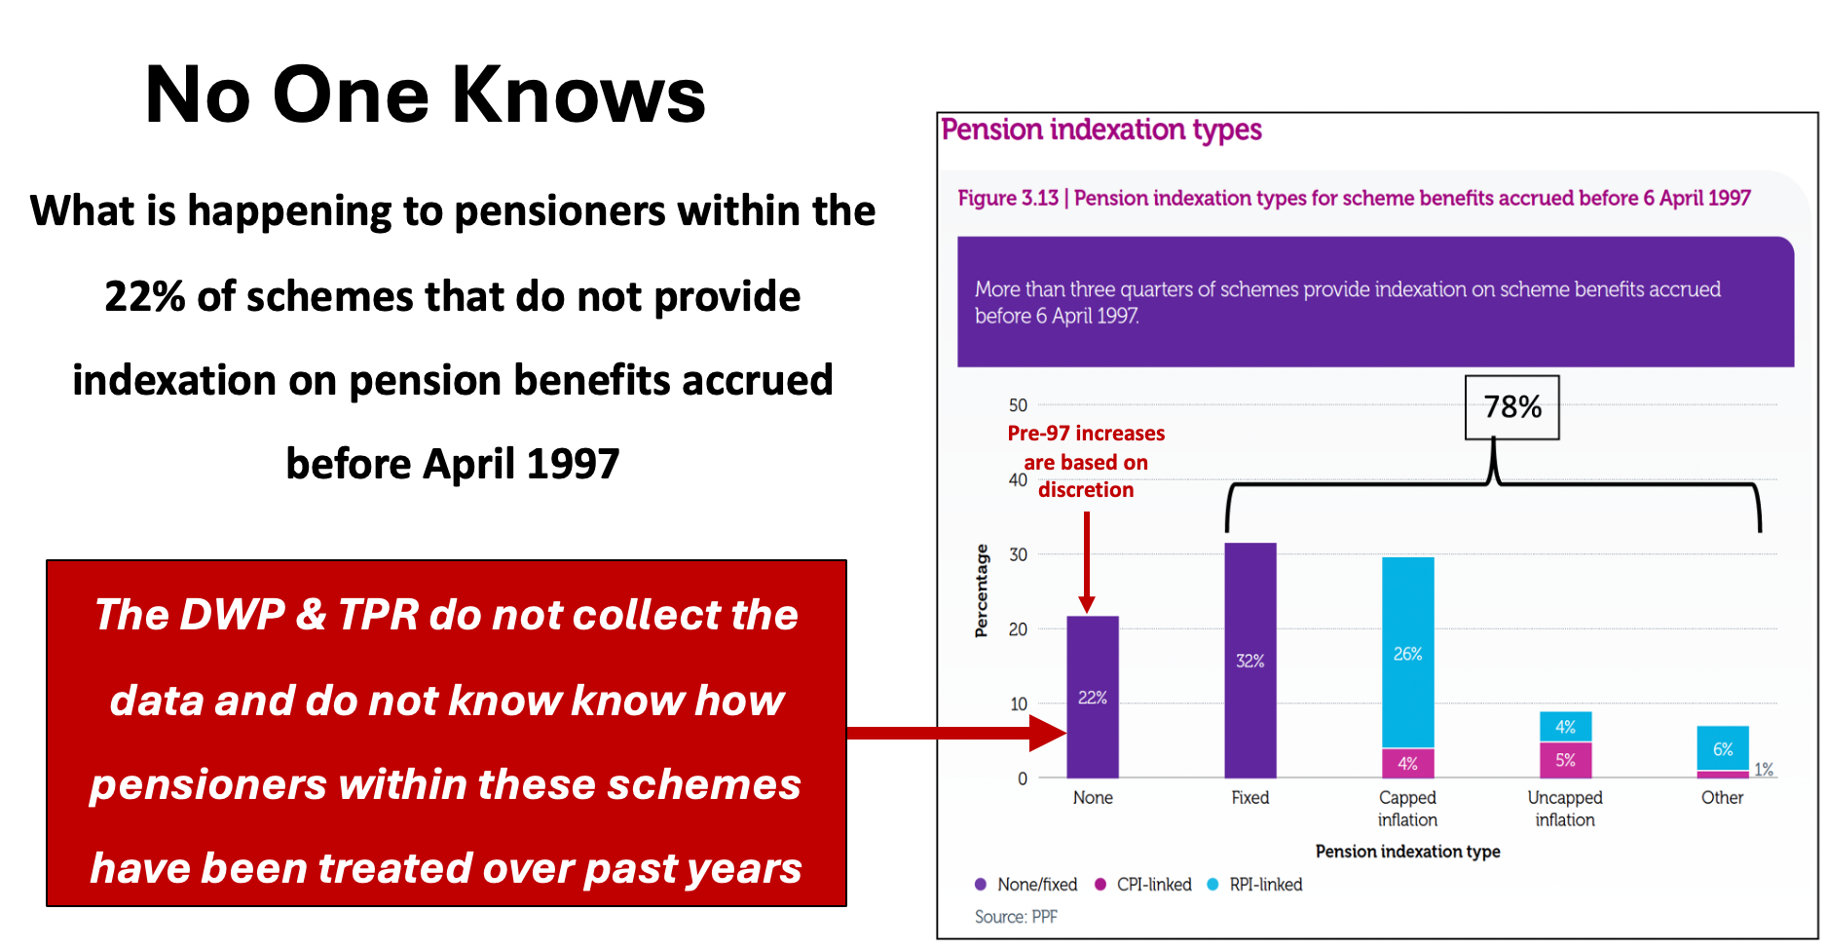

Slide 28
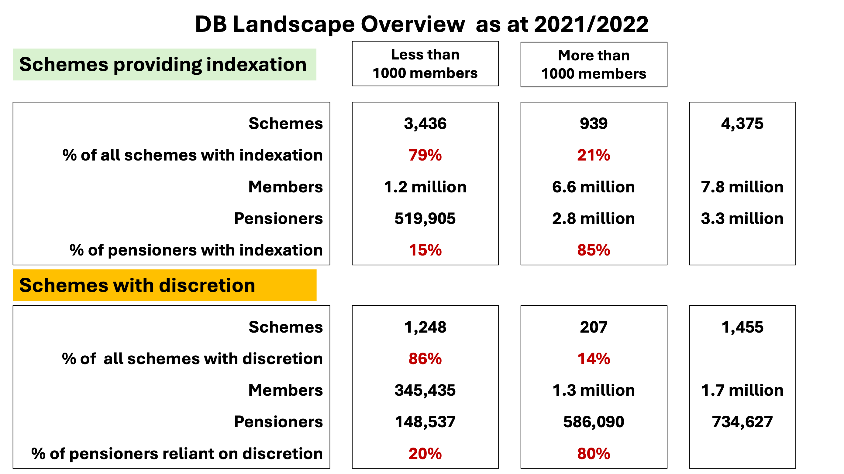

Slide 29
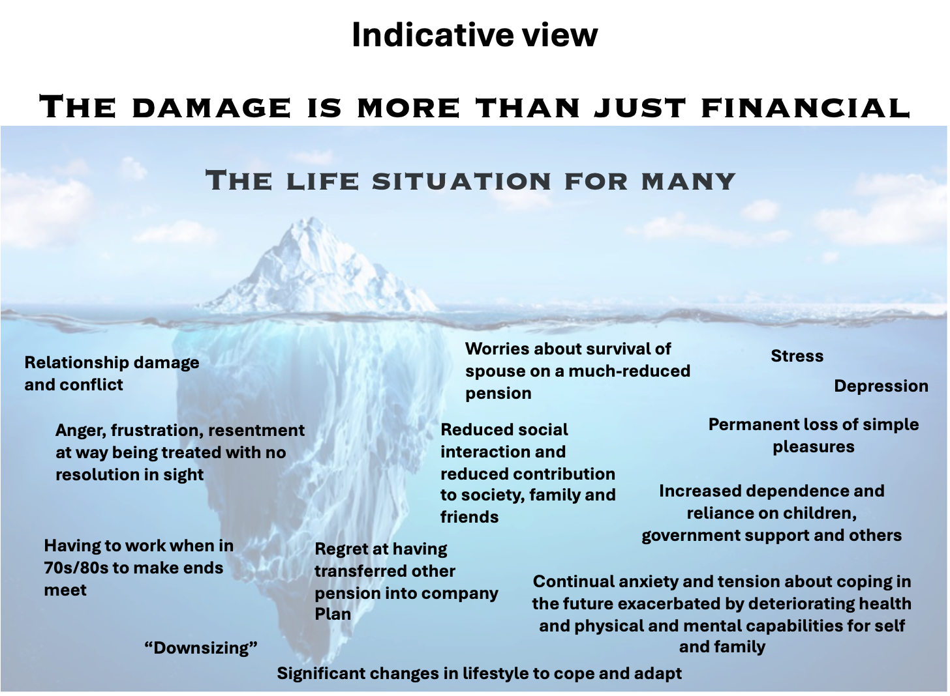

Slide 30
